Slide 1

Alert Manager

Slide 2
Alert Manager Basics
Overview
Access AlertManager UI
Logic Of Alerting
Core Concepts the Alertmanager
Configuration
Define Alerting Rules
Notification Template reference & Example
Query For Alerts
Management API

Slide 3
Overview
Handles alerts sent by client applications like Prometheus
Alerting with Prometheus is separated into two parts.
Alerting rules in Prometheus servers send alerts to an Alertmanager
The Alertmanager then manages those alerts
The main steps to setting up alerting and notifications are:
Setup and configure the Alertmanager
Configure Prometheus to talk to the Alertmanager
Create alerting rules in Prometheus

Slide 4
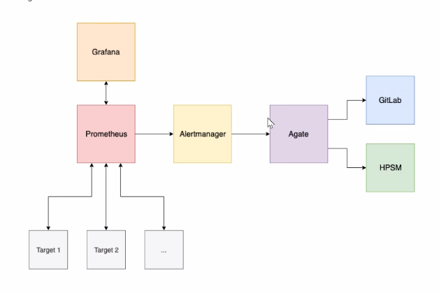
High level Architecture high-level overview of the major components of the Maul stack and roughly how they all fit together.

Slide 5
Logic Of Alerting & Alert Manager UI
Process of generating an alert or a notification based on the event
Defined alerting rules triggered an alert based on collected matrics
Alerting rules can be defined in application or exporter like prometheus

Slide 6
Agate
Prometheus alertmanager webhook that responds to alerts by generating tickets, executing ansible roles and running scripts.

Slide 7
Core Concepts the Alertmanager
It takes care of deduplicating, grouping, and routing them to the correct receiver integration such as email, PagerDuty, or OpsGenie. It also takes care of silencing and inhibition of alerts.
The following describes the core concepts the Alertmanager
Grouping
Inhibition
Silences
Client behavior
High Availability

Slide 8
Grouping
Grouping categorizes alerts of similar nature into a single notification
Useful during larger outages when many systems fail at once and hundreds to thousands of alerts may be firing simultaneously.
Example
hundreds of instances of a service are running in cluster and Half of service instances can no longer reach the database so in this scenario need require send to an alert notification for each system so as result hundreds of are sent to Alertmanager.
So Grouping of alerts, timing for the grouped notifications, and the receivers of those notifications are configured by a routing tree in the configuration file.

Slide 9
Inhibition
It is a concept of suppressing notifications for certain alerts if certain other alerts are already firing.
Example
An alert is firing that informs that an entire cluster is not reachable. Alertmanager can be configured to mute all other alerts concerning this cluster if that particular alert is firing. This prevents notifications for hundreds or thousands of firing alerts that are unrelated to the actual issue.
Inhibitions are configured through the Alertmanager's configuration file.

Slide 10
Client behavior
The Alertmanager has special requirements for behavior of its client. Those are only relevant for advanced use cases where Prometheus is not used to send alerts.
High Availability
Alertmanager supports configuration to create a cluster for high availability. This can be configured using the --cluster-* flags.
It's important not to load balance traffic between Prometheus and its Alertmanagers, but instead, point Prometheus to a list of all Alertmanagers.

Slide 11
Configuration routes and receivers
Alertmanager is configured via command-line flags and a configuration file
Alertmanager can reload its configuration at runtime
To specify which configuration file to load, use the --config.file flag.
./alertmanager --config.file=alertmanager.yml
Example file for configuration
https://github.com/prometheus/alertmanager/blob/master/doc/examples/simple.yml

Slide 12
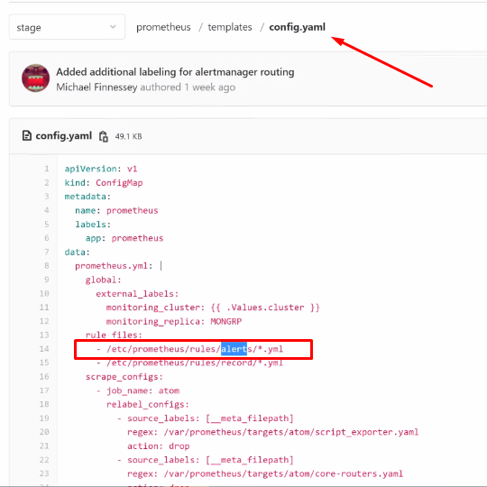
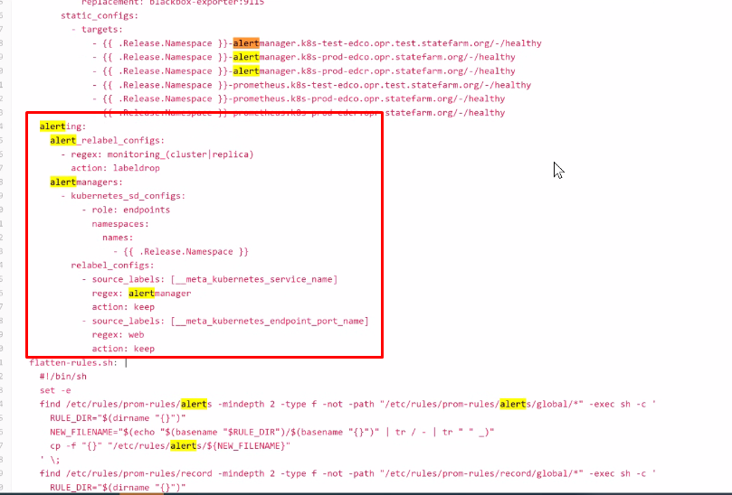
Configuration In Prometheus for AlertManager

Slide 13
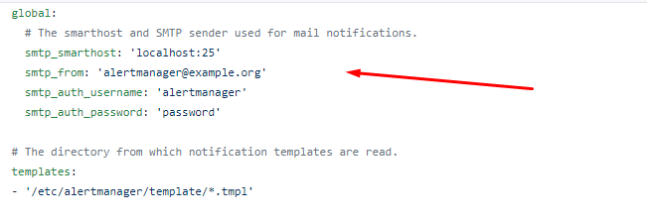
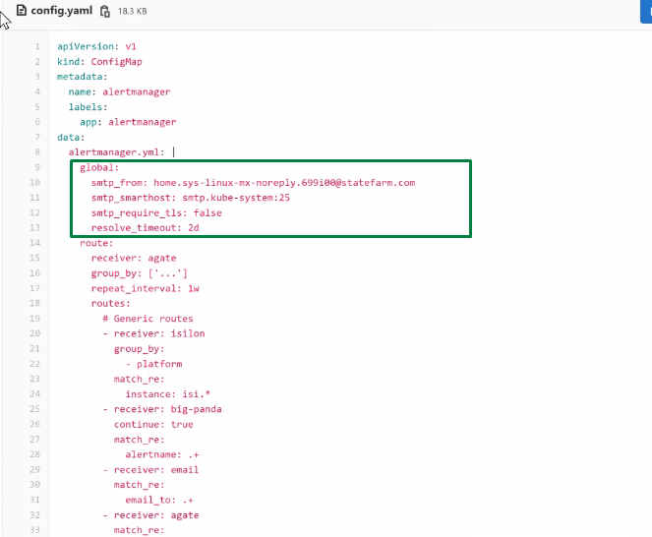
Configuration for AlertManager
Global & Templates :
configuraiton which will be common and used globaly

Slide 14
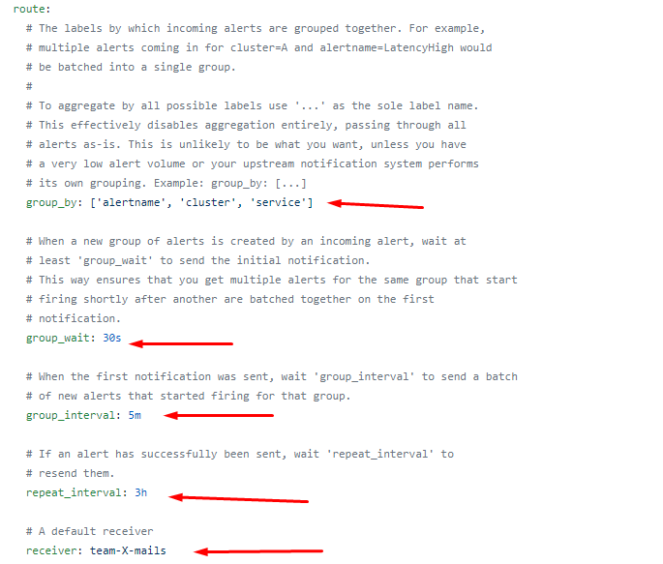
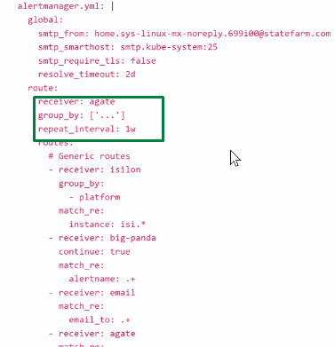
Configuration for AlertManager Continue...
Route:
# All the above attributes are inherited by all child routes and can overwritten on each.

Slide 15
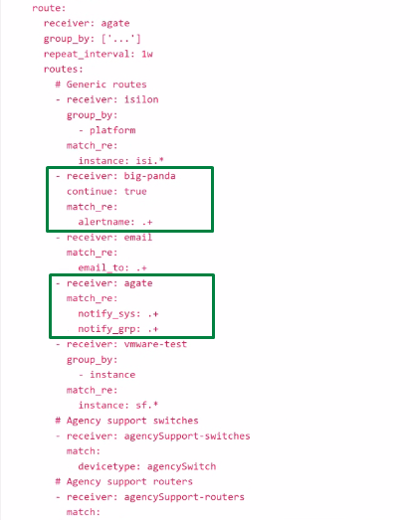
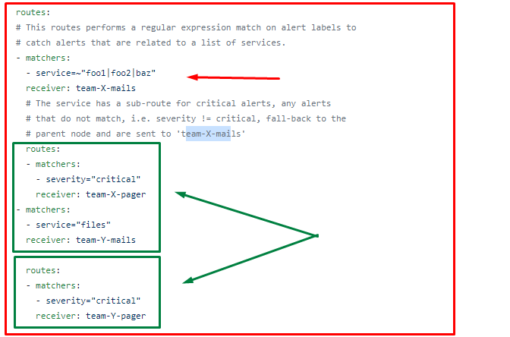
Configuration for AlertManager Continue...
Routes:
# The child route trees.

Slide 16
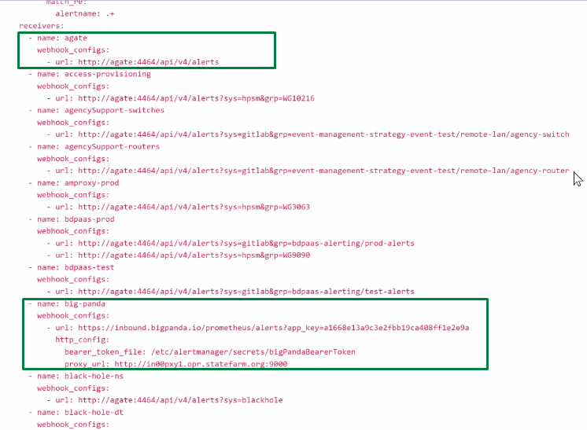
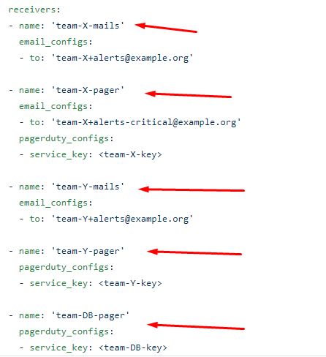
Configuration for AlertManager Continue...
Receivers :

Slide 17
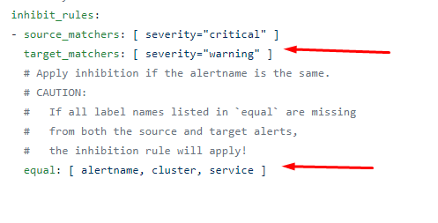
Configuration for AlertManager Continue...
Inhibition rules :
#Inhibition rules allow to mute a set of alerts given that another alert is firing.

Slide 18
Defining alerting rules
Alerting rule files are defined according the following YAML specification. Generic placeholders are defined as follows:
<duration>: a duration matching the regular expression [0-9]+(ms|[smhdwy])
<labelname>: a string matching the regular expression [a-zA-Z_][a-zA-Z0-9_]*
<string>: a regular string
<tmpl_string>: a string which is template-expanded before usage
groups:
[ - <alerting_rule_group> ]

Slide 19
<alerting_rule_group> # The name of the group. Must be unique within a file. name: <string> rules: [ - <alerting_rule> ... ] <alerting_rule> alert: <string> expr: <string> [ for: <duration> | default = 0s ] labels: [ <labelname>: <tmpl_string> ... ] annotations: [ <labelname>: <tmpl_string> ... ]

Slide 20
Notification Template reference & Example
The notifications sent to receivers are constructed via templates.
The Alertmanager comes with default templates but they can also be customized.
Important to note that the Alertmanager templates differ from templating in Prometheus
The Alertmanager's notification templates are based on the Go templating system

Slide 21
Notification System
There are below ways through which one can receive notification
Email
GitLab
HPSM (Hp Enterprise Service Manager)
Email
To deliver an alert via email, attach the email_to label to the alert. The value of that label should be a comma-delimited list of email addresses.
GitLab
Notification sent to GitLab are created as issues. Thus, the destination project must have issues enabled
Additionally, to allow issues to be automatically closed when they resolve, the maulccop user must be granted Reporter access to the destination project.
HPSM
Notification sent to HPSM are created as incidents.

Slide 22
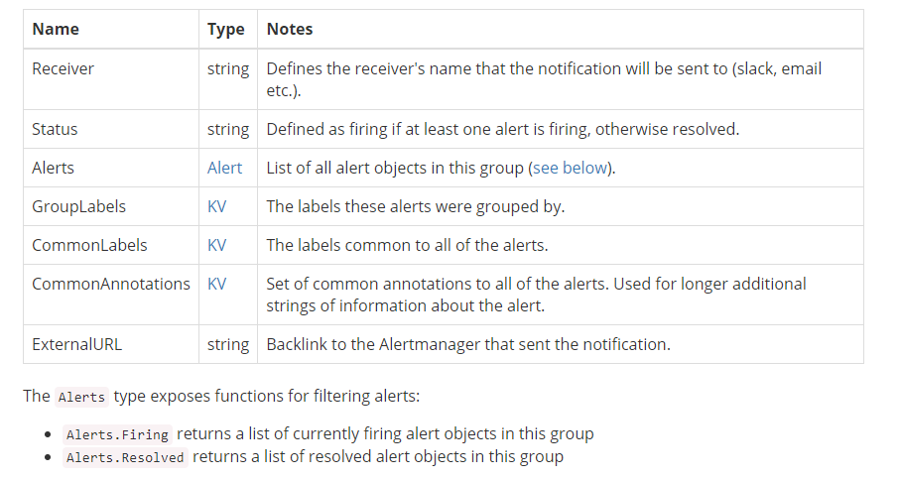
Data Structure of Template
Data
Data is the structure passed to notification templates and webhook pushes.

Slide 23
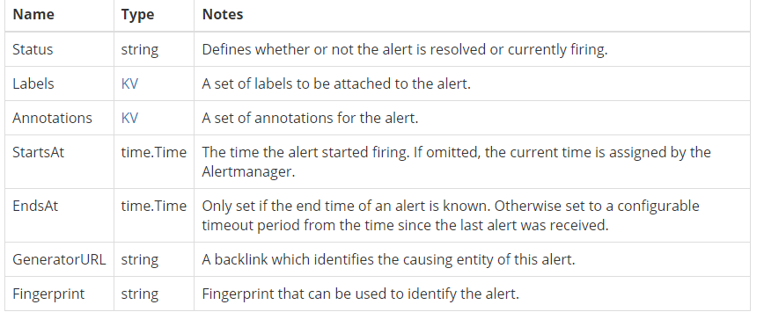
Data Structure of Template Continue...
Alert
Alert holds one alert for notification templates.

Slide 24
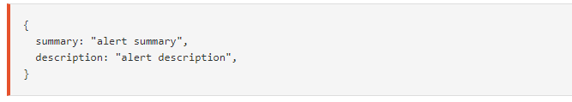
Data Structure of Template Continue...
KV
-KV is a set of key/value string pairs used to represent labels and annotations.
Annotation example containing two annotations:

Slide 25
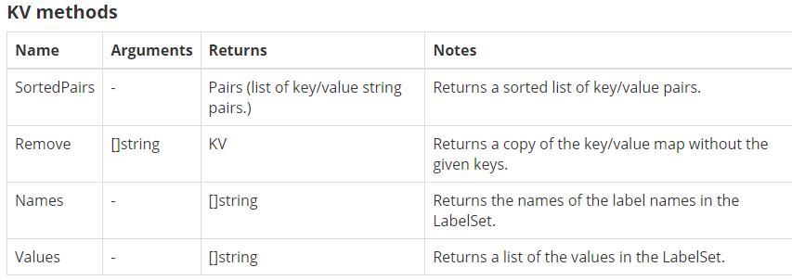
Data Structure of Template Continue...
KV
In addition to direct access of data (labels and annotations) stored as KV, there are also methods for sorting, removing, and viewing the LabelSets:
Annotation example containing two annotations:

Slide 26
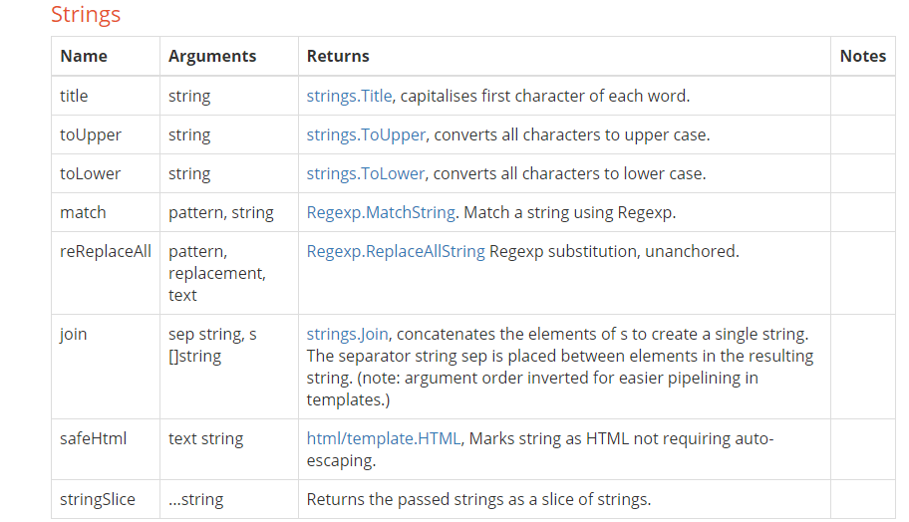
Data Structure of Template Continue...
FUNCTIONS
Note the default functions also provided by Go templating.

Slide 27
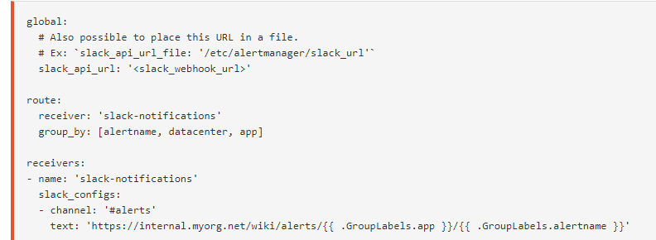
NOTIFICATION TEMPLATE EXAMPLES
Customizing Slack notifications
In this example we've customised our Slack notification to send a URL to our organisation's wiki on how to deal with the particular alert that's been sent.

Slide 28



MANAGEMENT API
Alertmanager provides a set of management API to ease automation and integrations.
Health check
This endpoint always returns 200 and should be used to check Alertmanager health.
Readiness check
This endpoint returns 200 when Alertmanager is ready to serve traffic (i.e. respond to queries).
Reload

Slide 29
Thank you

